Slide 1
Capstone Project
Netflix Movies and TV Shows Clustering By Krushna Chaure Data Science Trainee AlmaBetter,Bangalore

Slide 2
Topic for Discussion
1. Introduction
2. Problem Statement
3. Understand Dataset
4. Null Values/Missing Values Treatment
5. Data Wrangling
6. EDA(Exploratory Data Analysis)
(a) Univariate
(b) Bivariate
(c) Multivariate
7. Data Preprocessing
8. Challenges Faced
9. ML Model Implementation
(a) K-Means Clustering
(b) Agglomerative Hierarchical Clustering
(c) Content Based Recommendation System
10. Conclusion

Slide 3
Introduction
Unsupervised Learning is a machine learning technique in which the model is not supervised by the training set instead we find hidden patterns and insight from the given data. It is a machine learning technique in which model are trained on the unlabeled data set without any supervision. A cluster is a collection of elements that are similar to each other but dissimilar to the elements belonging to other clusters. Netflix is a company that manages a large collection of TV shows and movies, streaming it anytime via online. This business is profitable because users make a monthly payment to access the platform. However, customers can cancel their subscriptions at any time. Therefore, the company must keep the users hooked on the platform and not lose their interest. This is where recommendation systems start to play an important role, providing valuable suggestions to users is essential. Netflix’s recommendation system helps them increase their popularity among service providers as they help increase the number of items sold, offer a diverse selection of items, increase user satisfaction, as well as user loyalty to the company, and they are very helpful in getting a better understanding of what the user wants. Then it’s easier to get the user to make better decisions from a wide variety of movie products. With over 139 million paid subscribers (total viewer pool -300 million) across 190 countries, 15,400 titles across its regional libraries and 112 Emmy Award Nominations in 2018 — Netflix is the world’s leading Internet television network and the most-valued largest streaming service in the world. The amazing digital success story of Netflix is incomplete without the mention of its recommender systems that focus on personalization. There are several methods to create a list of recommendations according to your preferences.

Slide 4
Problem Statement
Netflix is the world's largest online streaming service provider, with over 220 million subscribers as of 2022-Q2. It is crucial that they effectively cluster the shows that are hosted on their platform in order to enhance the user experience, thereby preventing subscriber churn.
In 2018, they released an interesting report which shows that the number of TV shows on Netflix has nearly tripled since 2010. The streaming service’s number of movies has decreased by more than 2,000 titles since 2010, while its number of TV shows has nearly tripled. It will be interesting to explore what all other insights can be obtained from the same dataset.
We will be able to understand the shows that are similar to and different from one another by creating clusters, which may be leveraged to offer the consumers personalized show suggestions depending on their preferences.
The goal of this project is to classify/group the Netflix shows into certain clusters such that the shows within a cluster are similar to each other and the shows in different clusters are dissimilar to each other.
In this project we do that:-
1. Exploratory Data Analysis.
2. Understanding what type content is available in different countries.
3. Is Netflix has increasingly focusing on TV rather than movies in recent years.
4. Clustering similar content by matching text-based features.

Slide 5
Understand Dataset
This dataset consists of tv shows and movies available on Netflix as of 2019. The dataset is collected from Flixable which is a third-party Netflix search.
The dataset contains 7787 records(Rows) and 12 attributes(Columns).
Attribute Information:-
1. show_id : Unique ID for every Movie / Tv Show
2. type : Identifier - A Movie or TV Show
3. title : Title of the Movie / Tv Show
4. director : Director of the Movie
5. cast : Actors involved in the movie / show
6. country : Country where the movie / show was produced
7. date_added : Date it was added on Netflix
8. release_year : Actual Release year of the movie / show
9. rating : TV Rating of the movie / show
10. duration : Total Duration - in minutes or number of seasons
11. listed_in : Genere
12. description: The Summary description

Slide 6
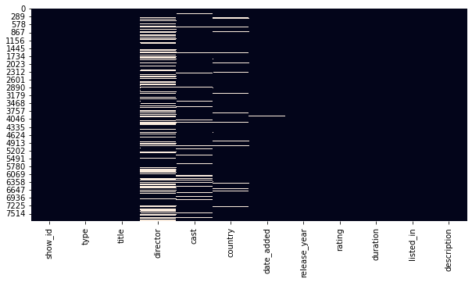
Null Values/Missing Values Treatment
There are many missing values in director, cast, country, date_added, and rating columns.
Hence The missing values in the director, cast, and country attributes can be replaced with 'Unknown' & The missing values in rating can be imputed with its mode, since this attribute is discrete & 10 records with missing values in the date_added column can be dropped.

Slide 7
Data Wrangling
1. let's consider only the primary country where that respective movie / TV show was filmed. Also, let's consider only the primary genre of the respective movie / TV show.
2. Converting 'duration' column datatype from string to integer
3. Converting 'date_added' column from string to datetime format
4. Changing the values name in the rating column for better understanding and insights.

Slide 8
EDA (Exploratory Data Analysis)
Here we understand the relationships between variables where Exploratory Data Analysis (EDA) is an approach to analyze the data using visual techniques. It is used to discover trends, patterns, or to check assumptions with the help of statistical summary and graphical representations.
We analysis into 3 types:-
1. Univariate Analysis:-
Univariate analysis explores each variable in a data set, separately. Uni means one, so in other words the data has only one variable. Univariate data requires to analyze each variable separately.
2. Bivariate Analysis:-
Bivariate analysis is one of the statistical analysis where two variables are observed. here we analyze the changes occured between the two variables and to what extent.
3. Multivariate Analysis:-
Multivariate analysis (MVA) involves evaluating multiple variables (more than two) to identify any possible association among them.

Slide 9
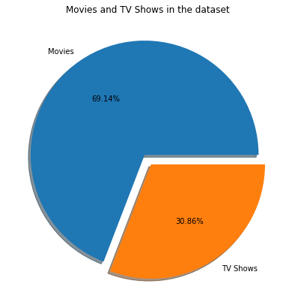
Univariate – Movies and TV Shows in the dataset
There are higher movies
69.14% in dataset
as compare to TV shows
30.86% in the dataset.

Slide 10
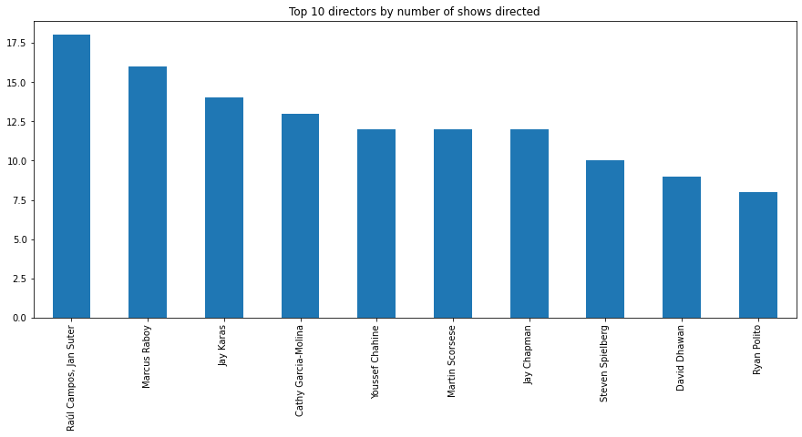
Univariate – Top 10 directors by number of shows directed
Raul Campos and Jan Suter together have directed 18 movies / TV shows, which is higher than anyone in the top 10 director in dataset. Ryan polito & david dhawan have lowest no of directed movies / TV shows which is 8 & 9 respectively in top 10 director dataset.

Slide 11
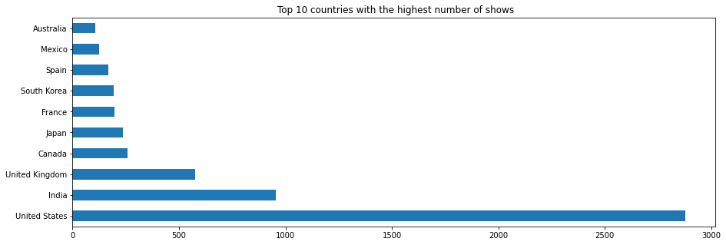
Univariate - Top 10 countries with the highest number of shows
United States are the top one country of highest number of movies / TV shows in the dataset and then after India & United Kingdom are 2 & 3 Number in dataset. Where the top ten countries together account for about 78% of all movies and TV shows in the dataset.

Slide 12
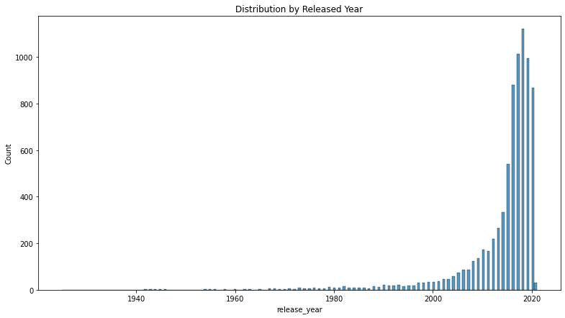
Univariate - Distribution by Released Year
Most number of movies / TV shows are released between 2000 to 2020 years where it goes high in recently years which between 2015 to 2020.

Slide 13
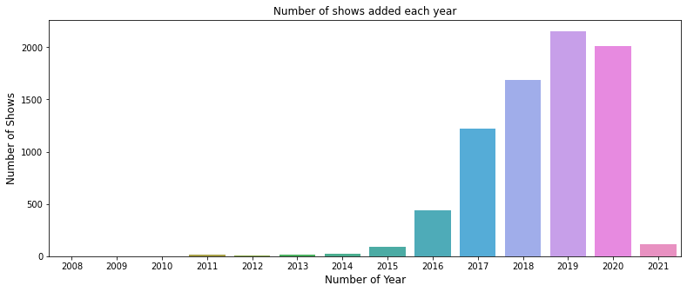
Univariate - Number of shows added each year
Netflix continuous to add more shows on its platform over the few years. There is a decrease in the number of shows added in the year 2020, which might be attributed to the covid-19-induced lockdowns, which halted the creation of shows.

Slide 14
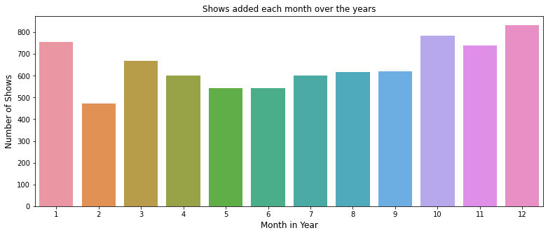
Univariate - Shows added each month over the years
Over the years a greater number of shows were added in the months of October, November, December, and January. February, May, June were less number of shows added Over the years.

Slide 15
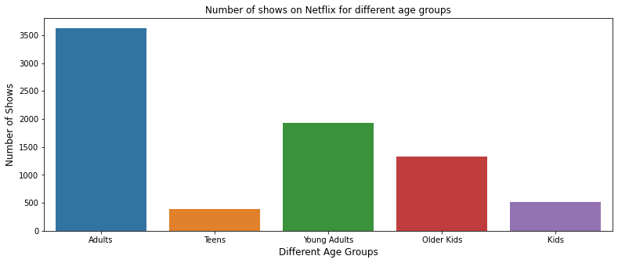
Univariate - Number of shows on Netflix for different age groups
Adults are the highest number of shows and second highest is Young Adults and third highest is older Kids shows. Teens and kids are less number of shows on netflix as compare to other.

Slide 16
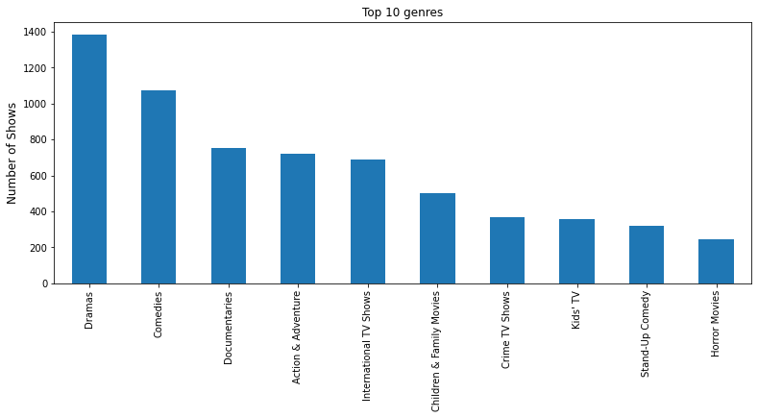
Univariate - Top 10 genres
There are top ten genres account for about 82% of all movies and TV shows. The dramas is the most popular genres then comedies genres is second highest and documentries is third highest.

Slide 17
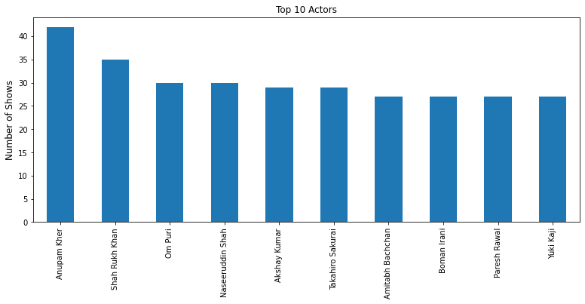
Univariate - Top 10 Actors
Anupam kher play highest role in movie/show where shah rukh khan play secong highest role in movie/show.

Slide 18
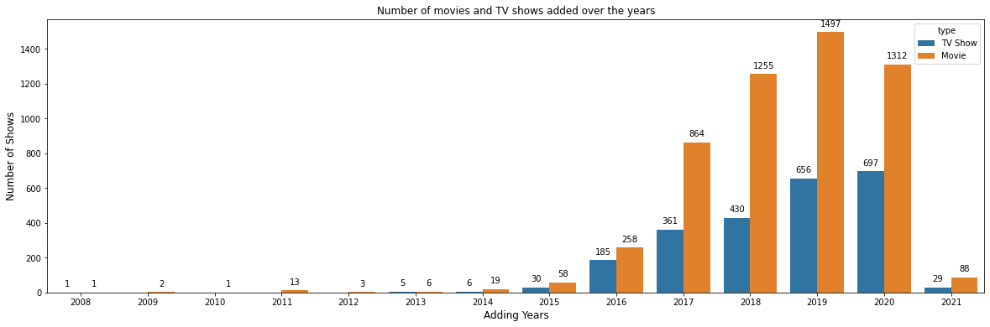
Bivariate - Number of movies and TV shows added over the years
Most of the years have more movies adding as compare to TV shows in Netflix. Also Over the last few years from 2015 to 2021 Netflix has consistently focused on adding more shows in its platform.

Slide 19
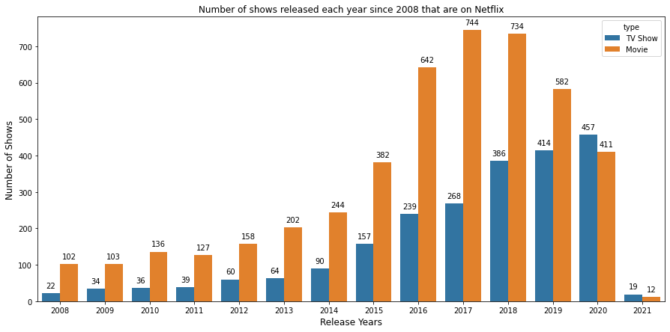
Bivariate - Number of shows released each year since 2008 that are on Netflix
From 2008 to 2018 Number of releaing Movies & TV Shows gradually increasing in each year. from year 2008 to 2019 movies releasing is higher compare to TV shows. Where year of 2017 & 2018 have highest number of releasing movies which is 744 & 734 respectively. Where year of 2019 & 2020 have highest number of releasing TV Show which is 414 and 457 respectively

Slide 20
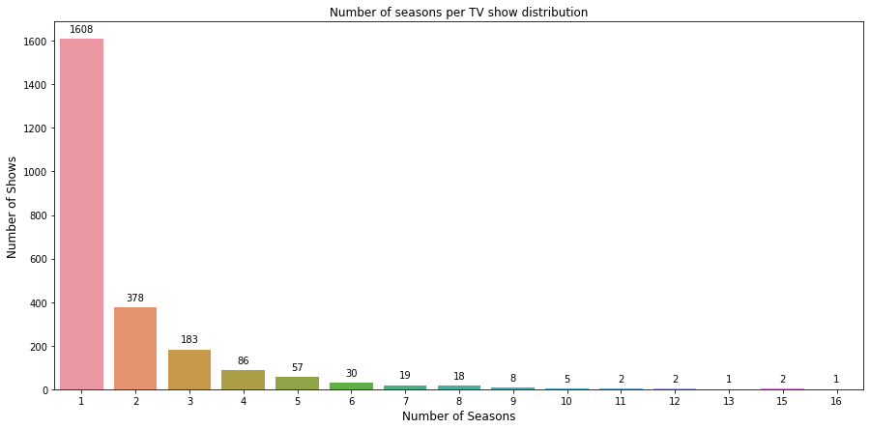
Bivariate - Number of seasons per TV show distribution
Total season of tv shows is upto 16. Most of the season of tv shows is one This might mean that the majority of TV shows has only recently begun, and that further seasons are on the way. There are very few TV shows that have more than 8 seasons.

Slide 21
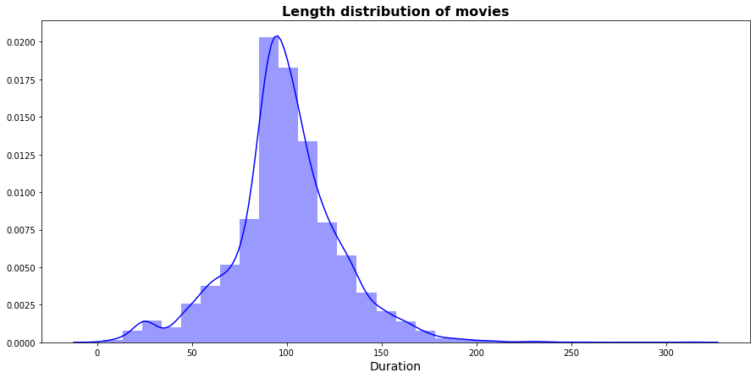
Bivariate - Length distribution of movies
The length of a movie may range from 3 min to 312 minutes. Most of the movie length between 50 to 150 min and there are very less movies hows length is above 200 min hence the distribution is almost normally distributed.

Slide 22
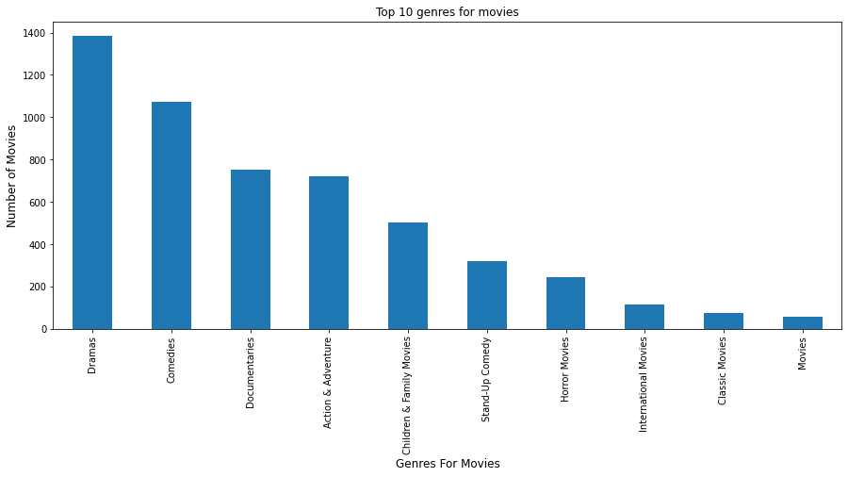
Bivariate - Top 10 genres for movies
Drama genre have the highest number of movies where comedies genre have second highest and documentries genre have third highest in dataset. Calssic movies genre and movie genre have ninth & tenth position respectively in dataset.

Slide 23
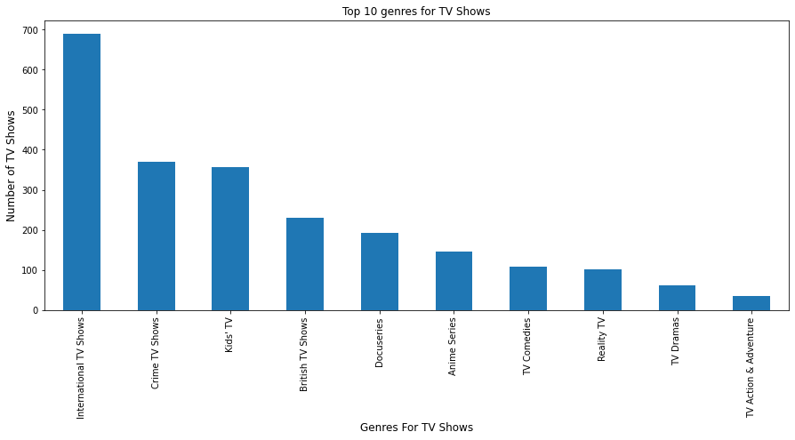
Bivariate - Top 10 genres for TV Shows
International genre have the highest number of TV Shows where crime genre have second highest and kids genre have third highest in dataset. Dramas genre and action&adventure genre have ninth & tenth position respectively in dataset.

Slide 24
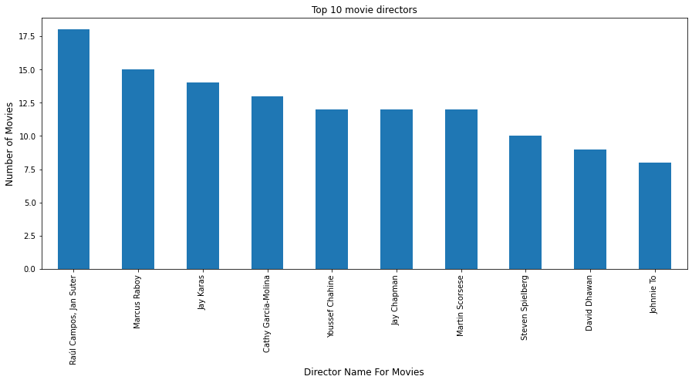
Bivariate - Top 10 movie directors
Raul Campos and Jan Suter have togather directed in 18 movies which is have the highest number of movies where Marcus Raboy have second highest and Jay Keras have third highest in dataset.

Slide 25
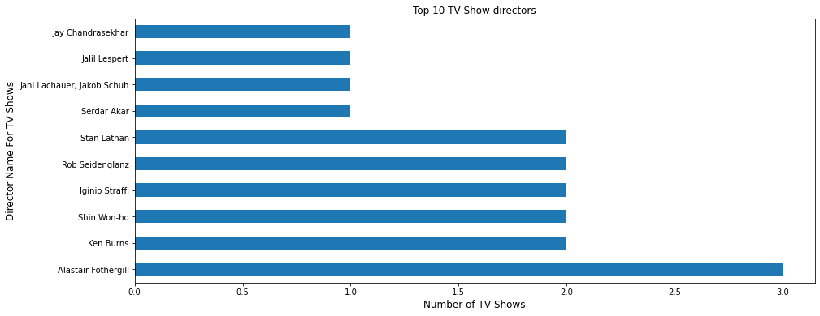
Bivariate - Top 10 TV Show directors
Alastair Fothergill has directed three TV shows, the most of any director. Only six directors have directed more than one television show, remaining all directors direct only one TV shows.

Slide 26
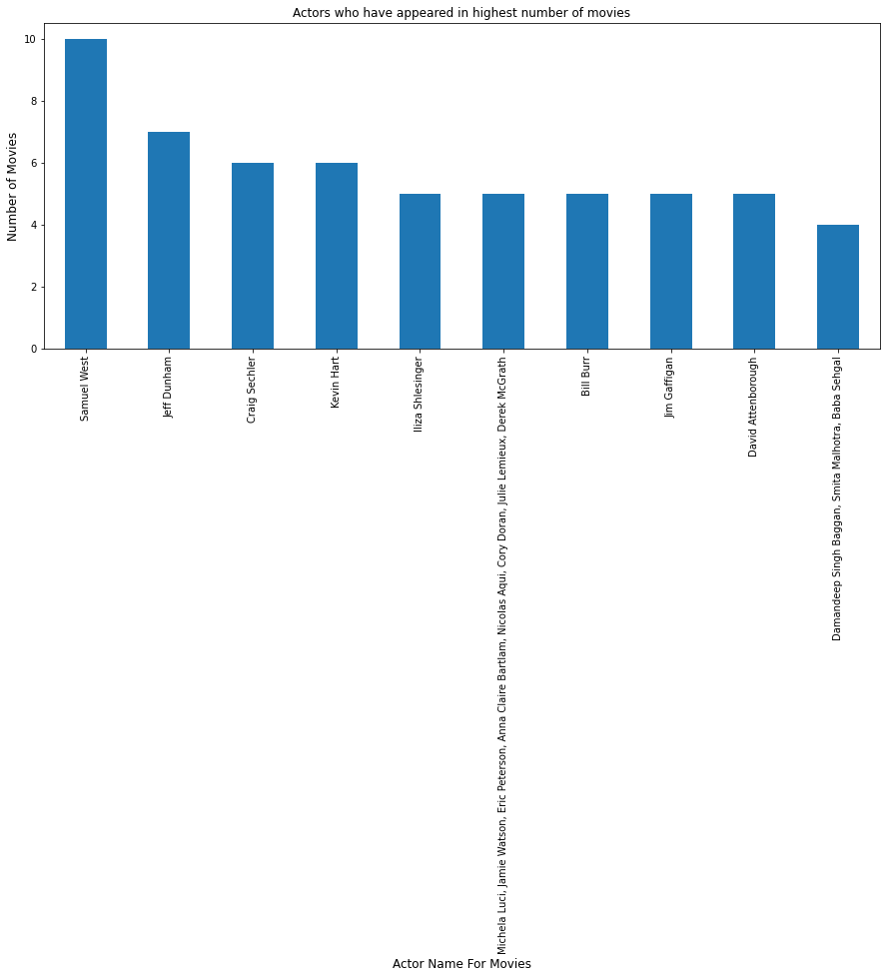
Bivariate - Actors who have appeared in highest number of movies
Top one actor in movies are Samuel West who appeared in 10 movies and second highest actor are jeff Dunham who appeared in 7 movies and third highest actor of movies are Craig Sechler and Kevin Hart who appeared in 6 movies equally.

Slide 27
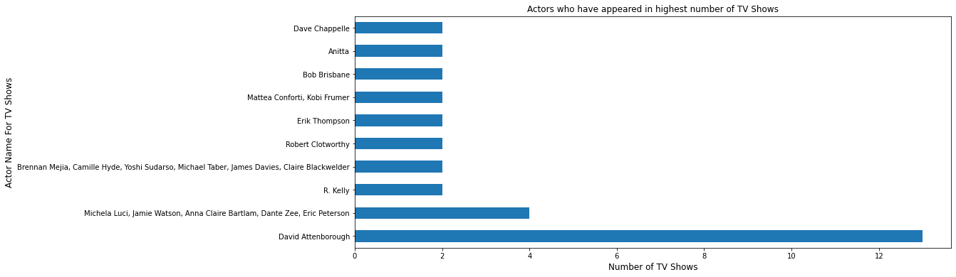
Bivariate - Actors who have appeared in highest number of TV Shows
David Attenborough has appeared in 13 TV shows, followed by Michela Luci, Jamie Watson, Anna Claire Bartlam, Dante Zee, Eric Peterson with 4 TV shows. remaining actors from third to tenth position have equally appeared 2 Tv Shows.

Slide 28
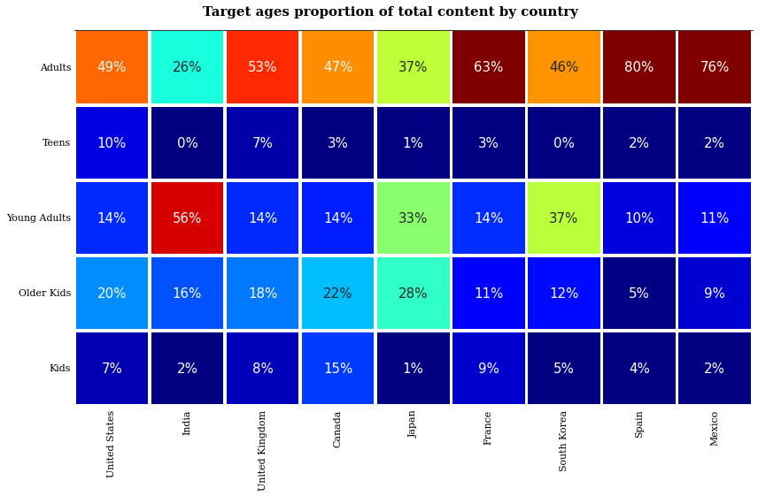
Multivariate - Correlation Heatmap
Most of the country targeted their customer in adult age category then after secondly young adults targeted. Most of the country less targeted to teens age category in that India & spain have 0% targeted.

Slide 29
Data Preprocessing
Data preprocessing is a process of preparing the raw data and making it suitable for a machine learning model. It is the first and crucial step while creating a machine learning model.
Below is some steps:-
1. Remove stopwords and lower case:- Stop words are words that are commonly used in a language but do not convey much meaning on their own, such as "a," "an," "the," and "is." These words can add noise to the data and can sometimes affect the performance of NLP models, so they are often removed as a pre-processing step.
Lowercasing words is the process of converting all the words in a text to lowercase. This is a common pre-processing step in NLP tasks, as it.
2. Removing non-ASCII characters:- Non-ASCII characters are those that are not encoded in ASCII, such as Unicode, EBCDIC, etc. ASCII is limited to 128 characters.
This approach uses a Regular Expression to remove the Non-ASCII characters from the string.
Only characters that have values from zero to 127 are valid.
3. Remove punctuations:- Punctuation marks like periods, commas, and exclamation points can add noise to the data and can sometimes be treated as separate tokens, which can affect the performance of NLP models.

Slide 30
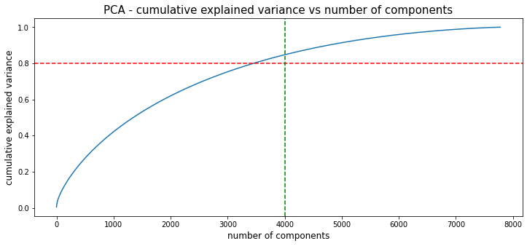
4. Lemmatization:- Lemmatization is the process of grouping together the different inflected forms of a word so they can be analyzed as a single item.So it links words with similar meanings to one word. This process allows to decrease noise and speed up the user's task.
5. Tokenization:- Tokenization is splitting the input data into a sequence of meaningful parts, tokenization reduces risk from data breaches, helps foster trust with customers.
6. Text Vectorization:- Word/Text vectorization is the process of representing words as numerical vectors. This is important in NLP tasks because most machine learning models expect numerical input and cannot work with raw text data directly. Word vectorization can also be used to measure the similarity between words using vector arithmetic. We can vectorize the corpus using TFIDF vectorizer, where TFIDF stands for Term Frequency Inverse Document Frequency.
7. Dimensionality reduction using PCA:- Dimensionality reduction is the process of reducing the number of features or dimensions in a dataset while preserving as much information as possible.
From this graph:- 100% variance explained by about nearly 7800
components. There are almost 80% of the variance is explained
just by 4000 components. Hence to simplify the model, and
reduce dimensionality, we can take the top 4000 components,
which will still be able to capture more than 80% of variance.

Slide 31
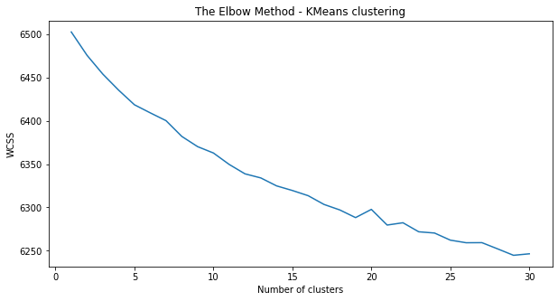
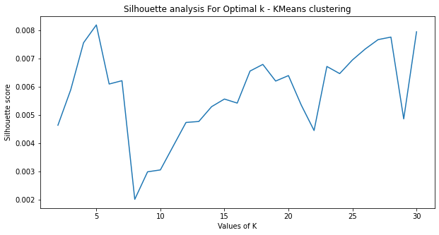
ML Model Implementation
1. K-Means Clustering
K-means clustering is an unsupervised machine learning algorithm that is used to divide a dataset into a specified number of clusters. It is called "unsupervised" because the algorithm does not use any labeled examples to learn about the data. Instead, it relies on the inherent structure of the data to group the samples into clusters.
The sum of squared distance between each highest Silhouette score is obtained for 6 clusters.
point and the centroid in a cluster (WCSS)
decreases with the increase in the number
of clusters.

Slide 32
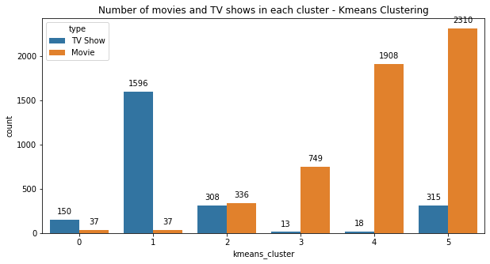
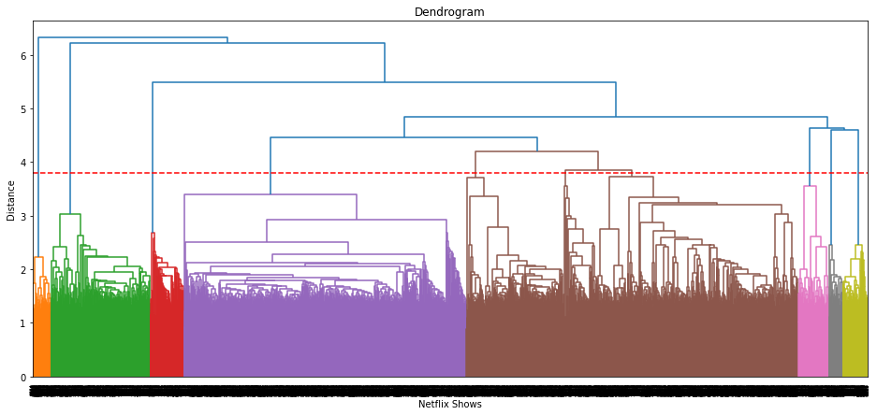
Successfully built 6 clusters using the k-means clustering algorithm.
2. Agglomerative (hierarchical) clustering algorithm.
Agglomerative hierarchical clustering is a method of clustering that is used to build a hierarchy of clusters. It is a bottom-up approach, where each sample is initially treated as a single-sample cluster and clusters are merged together as they are deemed similar.
The resulting clusters form a tree-like structure called a
dendrogram, which shows the relationships between the
clusters at each level of the hierarchy.
Visualizing the dendrogram to decide on the optimal number
of clusters.
Building 12 clusters using the Agglomerative clustering
Algorithm.

Slide 33
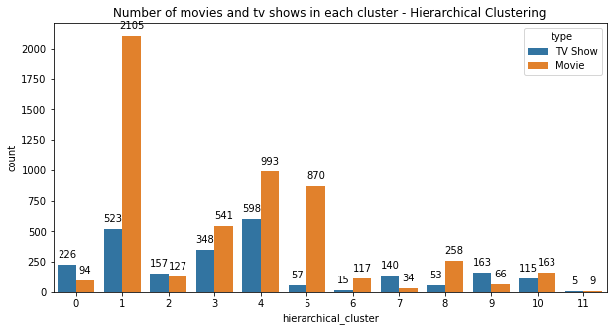
Successfully built 12 clusters using the Agglomerative (hierarchical) clustering algorithm.
3. Content Based Recommendation System
Content-based recommendation systems recommend items to a user by using the similarity of items. This recommender system recommends products or items based on their description or features. It identifies the similarity between the products based on their descriptions.
A content based recommender system was built using the similarity matrix obtained after using cosine similarity.

Slide 34
Challenges Faced
Data quality: The quality of the data used for clustering is important in determining the accuracy and relevance of the clusters. Incomplete or inaccurate data can affect the quality of the clusters.
Feature selection: Choosing the right features for clustering can be a challenge. Features that are too similar or too dissimilar can lead to irrelevant clusters. It is important to select features that are representative of the data and capture the underlying patterns.
Algorithm selection: There are various clustering algorithms available to use for this type of project, such as K-means, hierarchical clustering, and DBSCAN. Choosing the right algorithm and tuning its hyperparameters can be a challenge.
Cluster evaluation: Evaluating the quality of the clusters can be a challenge. There are various metrics such as silhouette score, inertia, and Davies-Bouldin index that can be used to evaluate the quality of the clusters, but choosing the right metric can be difficult.
Interpreting the results: Interpreting the clusters and understanding what they represent can be a challenge. It requires domain knowledge and expertise to determine the meaning and relevance of the clusters.
Scalability: Clustering algorithms can be computationally intensive, and as the dataset grows, it can become a challenge to process and cluster the data in a reasonable amount of time.

Slide 35
Conclusion
In this project, we worked on a text clustering problem wherein we had to classify/group the Netflix shows into certain clusters such that the shows within a cluster are similar to each other and the shows in different clusters are dissimilar to each other.
The dataset contained about 7787 records, and 12 attributes.
We began by dealing with the dataset's missing values and doing exploratory data analysis (EDA).
It was found that Netflix hosts more movies than TV shows on its platform, and the total number of shows added on Netflix is growing exponentially. Also, majority of the shows were produced in the United States, and the majority of the shows on Netflix were created for adults and young adults age group.
It was decided to cluster the data based on the attributes: director, cast, country, genre, and description. The values in these attributes were tokenized, preprocessed, and then vectorized using TFIDF vectorizer.

Slide 36
Conclusion
6. Through TFIDF Vectorization, we created a total of 20000 attributes.
We used Principal Component Analysis (PCA) to handle the curse of dimensionality. 4000 components were able to capture more than 80% of variance, and hence, the number of components were restricted to 4000.
We first built clusters using the k-means clustering algorithm, and the optimal number of clusters came out to be 6. This was obtained through the elbow method and Silhouette score analysis.
Then clusters were built using the Agglomerative hierarchical clustering algorithm, and the optimal number of clusters came out to be 12. This was obtained after visualizing the dendrogram.
A content based recommender system was built using the similarity matrix obtained after using cosine similarity. This recommender system will make 10 recommendations to the user based on the type of show they watched.

Slide 37
Thank You

